Slide 1
COUNTRY APPROACHES TO SAFEGUARDS:
what’s working
and what challenges lie ahead?
REDD+ Day
Rio Conventions Pavilion at UNFCCC COP21
7 December 2015

Slide 2
Introduction
5 years since Parties agreed on the Cancun safeguards
7 broad aspirational principles of intent
Multiple REDD+ related safeguard requirements
Single country approach to meet different safeguards…?

Slide 3
Global review
Semi-structured interviews and consultations with government focal points :
Brazil; Costa Rica; DRC; Ecuador; Ghana; Malaysia; Mexico; Tanzania; Zambia
Series of regional South-South knowledge exchange events on safeguards over 2015:
Asia-Pacific – Quarter 1
Africa – Q2
Latin America – Q3
Desk review of the limited documentation published and unpublished
Purpose:
facilitate information exchange among REDD+ countries
improve evidence-based and needs-driven, technical assistance
inform expectations of international community regarding safeguards

Slide 4
Key findings
Common experiences and elements in country approaches to safeguards:
Setting goals and scope of safeguards application
Clarifying safeguards in accordance with national circumstances
Building on existing governance arrangements
Designing safeguards information systems
Engaging stakeholders

Slide 5
Setting goals
Determining which safeguards a country seeks to apply for REDD+
Cancun safeguards constitute the default, not minimum, safeguards
Some countries may choose to include additional safeguards in accordance with national and international policy (and funding) commitments
Setting scope
Determining what interventions chosen safeguards will be applied to
Vital to have a clear idea of what REDD+ actions might be implemented
Some countries that have chosen to embed REDD+ in low-carbon development or green growth strategies
These countries are applying the Cancun safeguards more broadly than just to REDD+ actions alone

Slide 6
Clarifying safeguards
Reaching a shared understanding of the rights and obligations embodied in the Cancun safeguards at the national level
Examining and utilizing existing PLRs can be important in this iterative clarification process
Crucial to anchor country-specific clarification to proposed REDD+ actions in national strategy
Clarifying the Cancun safeguards can also be central to the design of SIS

Slide 7
Building on existing governance arrangements
Policies, laws, regulations (PLRs)
Institutional arrangements
Information systems and sources
Grievance redress mechanisms
Law enforcement mechanisms
Foundation to address and respect Cancun safeguards
Allows countries to respond to safeguards commitments in a rigorous yet flexible manner
Gaps, weaknesses and/or possible inconsistencies need to be identified and resolved
Application and benefit beyond REDD+ - strengthen governance arrangements to meet multiple policy goals
1
2
3
4
5

Slide 8
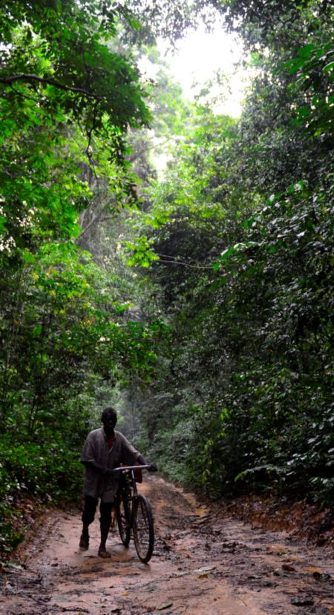
Designing safeguards information systems
Safeguards information system (SIS) - domestic institutional arrangement built on existing information systems and sources
SIS should meet national policy objectives, in addition to UNFCCC requirements - essential for justifying development and operational costs
Valuable in determining the information needs and structure of a SIS:
the specific REDD+ actions outlined in NS/AP
clarification of the Cancun safeguards
assessment of existing systems and sources
Potential SIS functions to be considered in the design phase - compilation, analysis, validation and dissemination of information

Slide 9
Engaging stakeholders
Success of a country’s approach to safeguards depends on stakeholder ownership
across a wide range of constituencies
2 main challenges emerging:
Raising awareness of safeguards requirements, thematic issues and stakeholder responsibilities
Building capacities so stakeholders can effectively engage in safeguards processes
Managing stakeholder expectations is crucial
need to ensure the clarity of messages, how messages should be communicated and when
Coordinating body can be highly conducive to advancing multi-stakeholder safeguards processes
national government-led
technical and/or political mandate

Slide 10
Conclusions
Setting goals and scope of safeguards application is an iterative process.
Clarifying safeguards in accordance with national circumstances will be required and informs other key steps the country’s approach to safeguards
Essential to anchor safeguards to NS/APs and to the specific REDD+ actions, In order for countries to demonstrate how they will address and respect safeguards
Building on existing governance arrangements lies at the heart of country approaches to safeguards → much greater than potential REDD+ alone
Safeguards information system design processes need to relate to:
specific REDD+ policies and measures
country’s clarification of the Cancun safeguards
Existing policies, laws, regulations, as well as systems/sources of information
Engaging stakeholders is paramount

Slide 11
Steve Swan
safeguards@un-redd.org
Thank You

